Slide 1

AUTOMATION TESTING
SELENIUM

Slide 2
Agenda
Introduction to Selenium
Selenium IDE in Chrome Browser
Eclipse Project setup with Selenium Jars
WebDriver and Browser Commands
Types of Locators

Slide 3
Automation Testing
Frequent regression testing
Repeated test case Execution is required
User Acceptance Tests
Faster Feedback to the developers
Reduce the Human Effort
Test same application on multiple environments

Slide 4
What is selenium?
Selenium is a suite of tools that automates browsers across many platforms.
https://www.selenium.dev/
Selenium first came to life in 2004 when Jason Huggins was testing an internal application in ThoughtWorks.
Components of selenium,
1.selenium IDE
2.selenium RC
3.selenium WebDriver
4.Selenium Grid

Slide 5
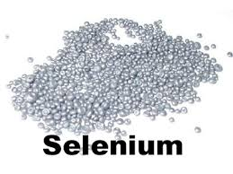

Why the name Selenium?
Selenium is a chemical element with symbol Se and atomic number 34
Selenium is a well-known antidote for Mercury poisoning

Slide 6
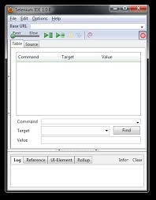
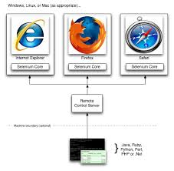
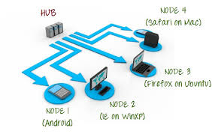
IDE/RC/GRID

Slide 7

Selenium supported languages ,browsers and OS

Slide 8
Selenium Webdriver
Simon Stewart created WebDriver (2006)when browsers and web applications were becoming more powerful and more restrictive with JavaScript programs like Selenium Core.
It was the first cross-platform testing framework that could control the browser from the OS level

Slide 9
Driver Instantiation
IE driver
System.setproperty(“webdriver.ie.driver” , “path of iedriver.exe”);
WebDriver driver = new InternetExplorerDriver();
Chrome driver
System.setproperty(“webdriver.chrome.driver” , “path of chromedriver.exe”);
WebDriver driver = new ChromeDriver();
Firefox driver
System.setproperty(“webdriver.gecko.driver” , “path of geckodriver.exe”);
WebDriver driver = new FirefoxDriver();

Slide 10
Commonly used methods
driver.get(url)
driver.close()
driver.quit()
driver.navigate().to()
driver. navigate().back()
driver. navigate().forward()
driver. navigate().refresh()

Slide 11
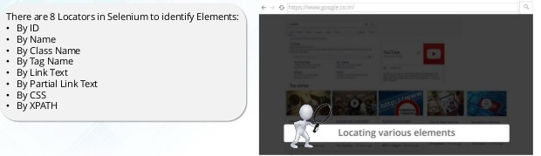
Locators and types
To identify the elements on the web page

Slide 12
By.id()
Locates elements by the value of their "id" attribute
By.className()
Finds elements based on the value of the "class" attribute
By.Xpath()
Locates elements via Xpath
By.cssSelector()
Finds elements based on the driver's underlying CSS Selector engine
driver.findElement(By.locatorname(“attribute value”))-general synatax

Slide 13
By.linktext()
Finds a link element by the exact text it displays
By.partialLinkText()
Locates elements that contain the given link text
By.Name()
Locates elements by the value of the "name" attribute
By.tagName()
Locates elements by their tag name

Slide 14
XPATH
XPath is designed to allow the navigation of XML documents,with the purpose of selecting individual elements, attributes, or some other part of an XML document for specific processing.
Two types of Xpath
1.Absolute Xpath
2.Relative Xpath

Slide 15
Absolute Xpath
Absolute XPath starts with the root node or a forward slash (/). The advantage of using absolute is, it identifies the element very fast. Disadvantage here is, if any thing goes wrong or some other tag added in between, then this path will no longer works.
html/head/body/table/tbody/tr/th

Slide 16
Relative Xpath
A relative xpath is one where the path starts from the node of your choise - it doesn't need to start from the root node.
It starts with Double forward slash(//)
Syntax: //table/tbody/tr/td

Slide 17
Advantage of using relative xpath is, you don't need to mention the long xpath, you can start from the middle or in between.
Disadvantage here is, it will take more time in identifying the element as we specify the partial path not (exact path).
If there are multiple elements for the same path, it will select the first element that is identified

Slide 18
Xpath
Relative Xpath
//*[@attribute=‘value’]
Tagname ex: id,classname,type,linktext
//*[contains(@attribute=‘value’)]
//*[starts_with(@attribute=‘value’)]
//*[end_with(@attribute=‘value’)]

Slide 19
What is CSS?
Cascading Style Sheets (CSS) is a style sheet language used for describing the presentation semantics (the look and formatting) of a document written in a markup language such as HTML or XML
Syntax
tagName[attributename=attributeValue]

Slide 20
Example
driver.findElement(By.cssSelector("input[id=register-name]")).sendKeys("Gokilamani");
driver.findElement(By.cssSelector("input[name=username]")).sendKeys("Goki");
driver.findElement(By.cssSelector("input[type=email]")).sendKeys("gokilamani.rangaraj@meritain.com");

Slide 21
Web Driver SELECT Methods to work with Dropdowns
Element | Command | Description
Drop-Down Box | selectByVisibleText()/ deselectByVisibleText() | selects/deselects an option by its displayed text
 | selectByValue()/ deselectByValue() | selects/deselects an option by the value of its "value" attribute
 | selectByIndex()/ deselectByIndex() | selects/deselects an option by its index
 | isMultiple() | returns TRUE if the drop-down element allows multiple selection at a time; FALSE if otherwise
 | deselectAll() | deselects all previously selected options

Slide 22
Web Driver Select with Multiple Attribute
Element | Command | Description
Drop-Down Box | select.getOptions (); | Returns all the option elements displayed in this select tag (dropdown list)
 | select.getAllSelectedOptions(); | It will return all the option elements that are selected in the select tag.
 | Select.getFirstSelectedOption(); | It will return the first selected option in this select tag (or the currently selected option in a normal select)
 | select.isMultiple (); | To check whether the Select element supports selecting multiple options. This will be done by checking the value of the "multiple" attributes in Select tag.

Slide 23

Single Check box
CheckBox & Radio Button Operations are easy to perform and most of the times the simple ID attributes work fine for both of these.
The below is the simple command to do that:
WebElement checkBoxElement=driver.findElement(By.id("persist_box")); checkBoxElement.click();

Slide 24

Multiple checkbox
List<WebElement> elements = driver.findElements(By.xpath("//input[@type='checkbox']"));
System.out.println(Integer.toString(elements.size()));
for(WebElement el : elements){
el.click();
}

Slide 25
Implicit Wait
The implicit wait will tell to the web driver to wait for certain amount of time before it throws a "No Such Element Exception". The default setting is 0. Once we set the time, web driver will wait for that time before throwing an exception
driver.manage().timeouts().implicitlyWait(10,TimeUnit.SECONDS) ;

Slide 26
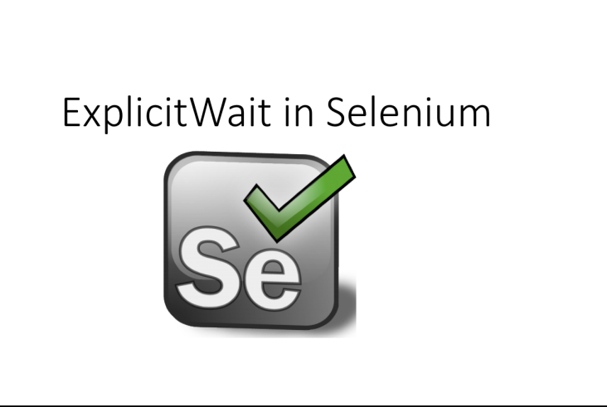
Explicit Wait
The explicit wait is used to tell the Web Driver to wait for certain conditions (Expected Conditions) or the maximum time exceeded before throwing an "ElementNotVisibleException" exception.
wait.until(ExpectedConditions.elementToBeClickable(By.linkText("ByLinkText")));

Slide 27
Alert and Types
Alert is a small message box which displays on-screen notification to give the user some kind of information or ask for permission to perform certain kind of operation. It may be also used for warning purpose.
Simple Alert
Confirmation Alert
Prompt Alert

Slide 28
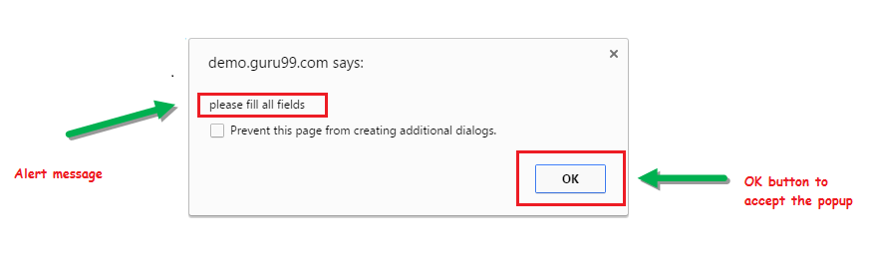
Simple Alert

Slide 29
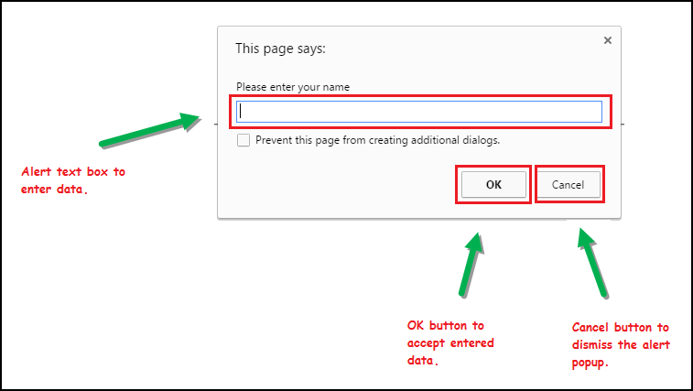
Prompt Alert

Slide 30
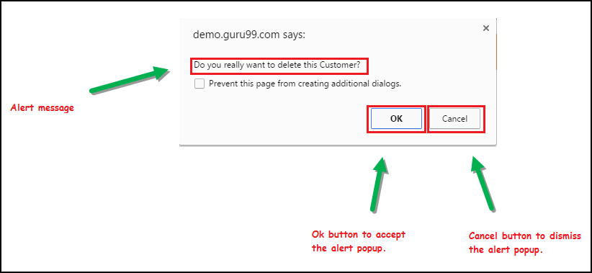
Confirmation Alert

Slide 31
void dismiss() // To click on the 'Cancel' button of the alert.
driver.switchTo().alert().dismiss();
void accept() // To click on the 'OK' button of the alert.
driver.switchTo().alert().accept();
String getText() // To capture the alert message.
driver.switchTo().alert().getText();
void sendKeys(String stringToSend) // To send some data to alert box.
driver.switchTo().alert().sendKeys("Text");

Slide 32
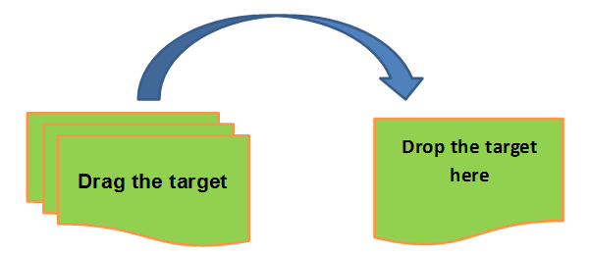
Drag and Drop
Actions.dragAndDrop(Sourcelocator, Destinationlocator)
First parameter "Sourcelocator" is the element which we need to drag
Second parameter "Destinationlocator" is the element on which we need to drop the first element

Slide 33
Windows Handling
In real time, we face many scenarios, where an application throws multiple popups. We can easily achieve this using Windows Handles in Selenium WebDriver. We use ‘Switch To’ method which allows us to switch control from one window to other.
driver.getWindowHandle();
driver.switchTo().window(windowelement);

Slide 34
Handling Frames
iFrame in Selenium Webdriver is a web page or an inline frame which is embedded in another web page or an HTML document embedded inside another HTML document. The iframe is often used to add content from other sources like an advertisement into a web page. The iframe is defined with the <iframe> tag.
driver.switchTo().frame(Indexvalue);
driver.switchTo().frame(id);

Slide 35
Web Tables
th1 | th2 | th3
tr[1]td[1] | tr[1]td[2] | tr[1]td[3]
tr[2] td[1] | tr[2] td[2] | tr[2] td[3]

Slide 36
Quiz -1
In Selenium WebDriver, which method closes all the open browsers?
quit()
close()
terminate()

Slide 37
2
Select the command which is used to check the presence of a web element?
verifyElementPresent
verifyTextPresent
isElementPresent
isElementExist

Slide 38
3
What is default wait time for implicit wait in Selenium WebDriver?
0 sec
15 sec
30 sec
None of the above

Slide 39
4
Select the below navigation methods of WebDriver?
forward()
back()
refresh()
click()

Slide 40
5
Select the correct option on how to select an element that contains “SoftwareTestingMaterial”
WebElement element = driver.findElement(By.xpath("//*[contains(text(), ' SoftwareTestingMaterial')]"));
WebElement element = driver.findElement(By.xpath("\\*[contains(text(), ' SoftwareTestingMaterial')]"));
WebElement element = driver.findElement(By.xpath("//*[text(' SoftwareTestingMaterial')]"));
None

Slide 41
6
Which statement is correct
“/” is used to create an absolute XPath and “//” is used to create relative XPath
“/” is used to create relative XPath and “//” is used to create an absolute XPath
Both “/” and “//” are used to create absolute XPath
Both “/” and “//” are used to create relative XPath

Slide 42
7
Running driver.get(“www.softwaretestingmaterial.com”) will:
Navigates to a page www.softwaretestingmaterial.com
No protocol is specified, so an exception will be thrown
Navigates to a page https://www.softwaretestingmaterial.com

Slide 43
8
Which command you use to retrieve the text using Selenium WebDriver?
getText()
getElementText()
getText(WebElement)
None of the above

Slide 44
9
Select the Wait below which is not provided by Selenium WebDriver?
Implicit Wait
Explicit Wait
Fluent Wait
Sleep

Slide 45
10
Which is not the type of the locators
ID
Link Text
Type Text
Name

Slide 46
11
Select the Operating system which is supported by Selenium WebDriver
i. Windows
ii. Mac OS
iii. Linux
i, ii
ii, iii
i, iii
i, ii, iii

Slide 47
12
The Selenium can
access elements outside of the web application under test
only test web applications
test both web and desktop applications
add elements to the inbuilt object repository

